Slide 1
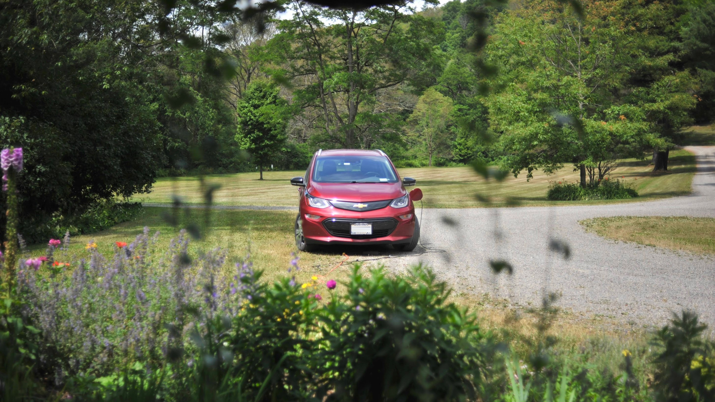
The Data Behind EV Driving
Debunking Common Electric Vehicle Myths
NYC Data Science Academy – Python Project
December 23, 2022
Brian Ralston
Notes:
Thank you all for your time, and welcome to my presentation: “De-Mystifying EV Driving: de-bunking”
For my presentation, I chose to explore a data set that I collected on my own.

Slide 2







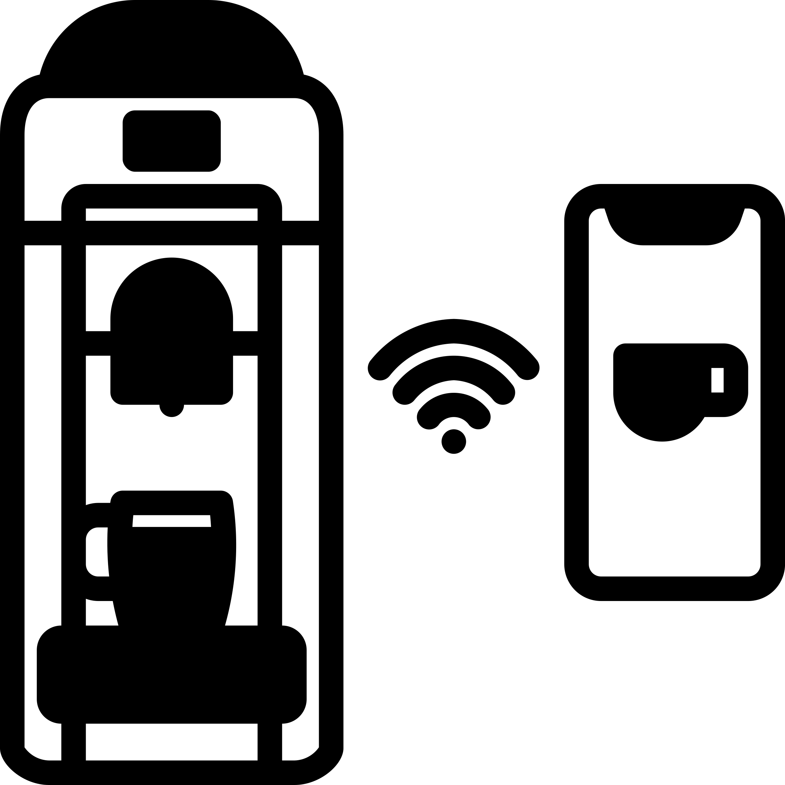

Internet of Things
Notes:
Private data has exploded over the past 10 years and become more and more accessible to the everyday user.
The power to collect your own data has shifted away from government and corporate entities, and is now in the hands of the individual.
The internet of things market is estimated to be a $1/2 Trillion Dollars industry with over 11 billion connected devises in 2021
Our Lives are filled with personal data from a wearable fitness devices collecting your heart rate, to a smart plug, detecting how much electricity you are using.

Slide 3
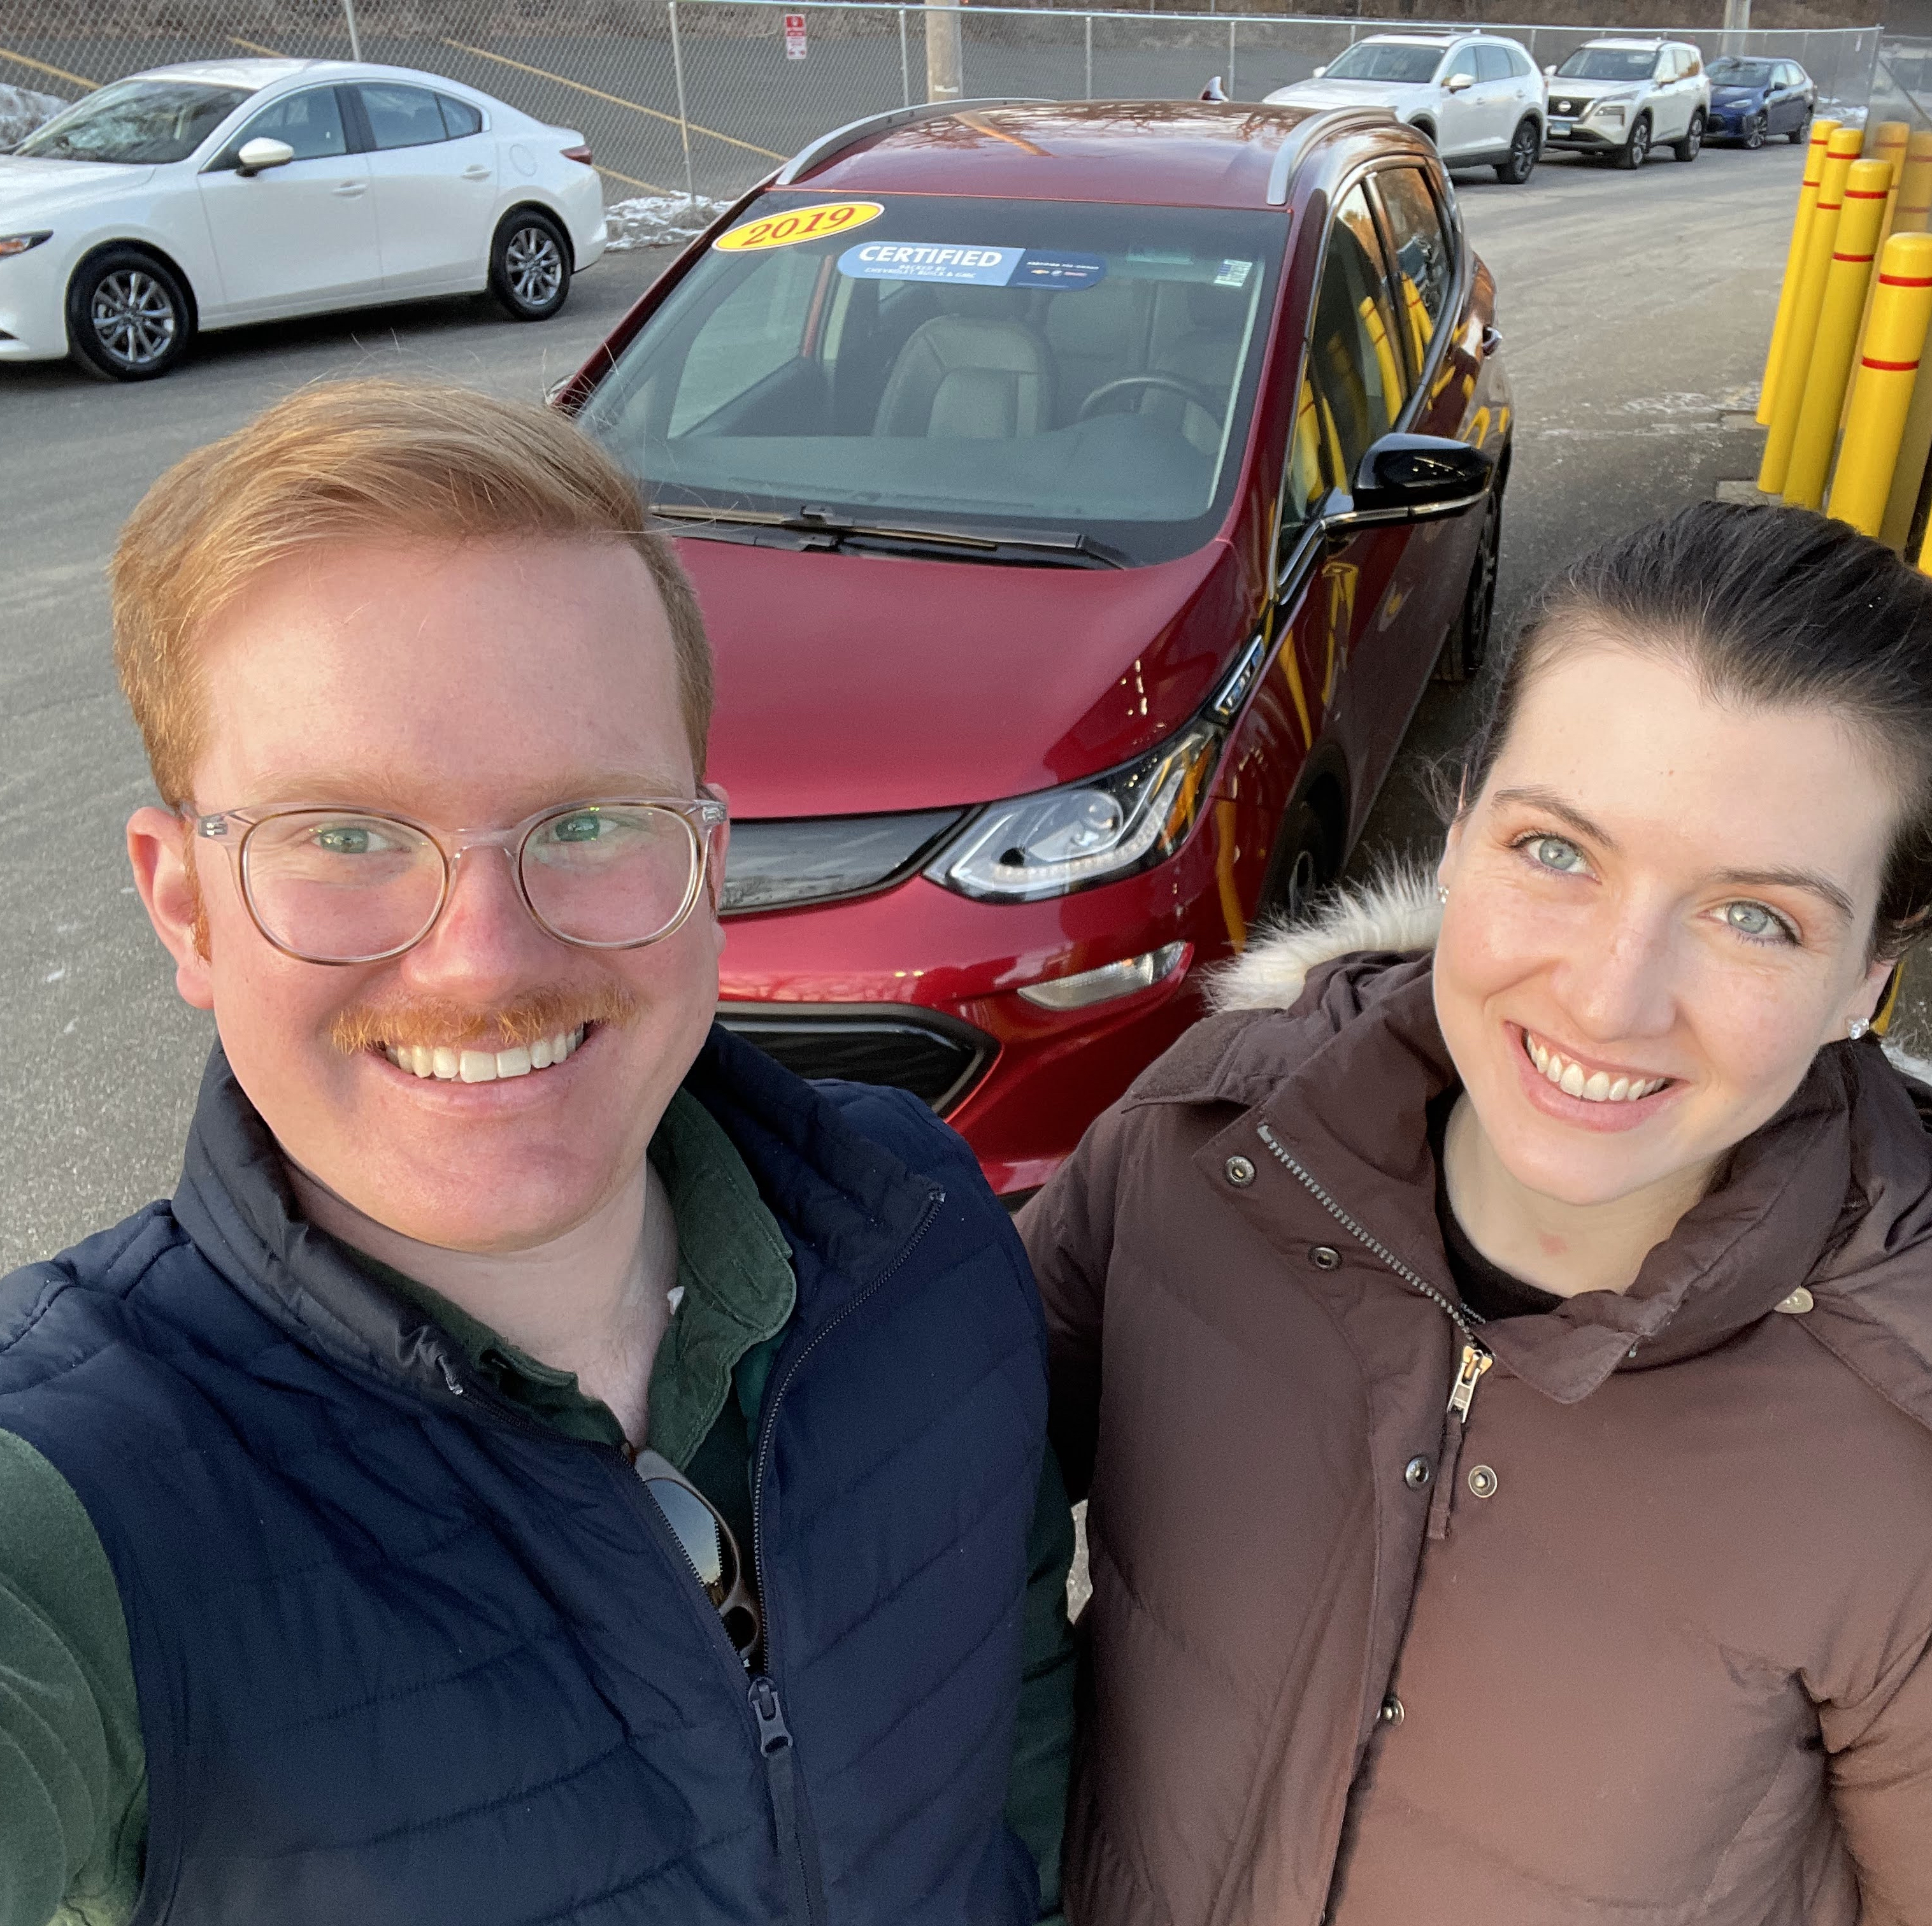
2019 Chevy Bolt (Fully Electric)
66 kWh Battery (Difficult to switch to this language)
Subcompact car
Notes:
This past February, my wife and I took the leap, and purchased an electric vehicle. A Fully-Electric 2019 Chevy Bolt with and EPA estimated range of 238 mi.
None of our friends and family had an electric vehicle, so we were scrounging for information about EV’s and the lifestyle change.
Leading up to the purchase, we did a ton of research, but still felt stuck wrestling with competing narratives about ‘going electric’
I scoured reddit forums, Chevy forums, and electric car YouTube channels for MONTHS leading up to this, and still there wasn’t enough clear data for me to feel very confident going into the purchase.
I’m a very type A person, so actually purchasing a vehicle without 100% confidence felt like jumping into the unknown.

Slide 4
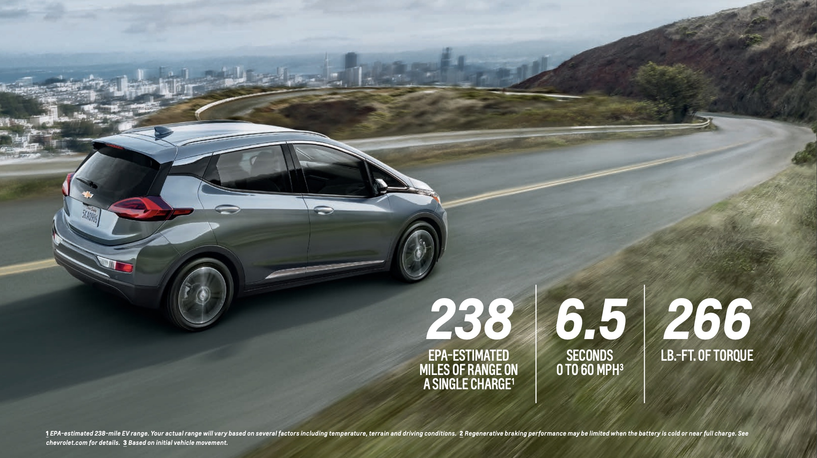
Notes:
Going into the purchase, I knew the following: That the car:
Has a range of 238 mi
It has a 200 horsepower motor with a 66kWh battery
And it can be plugged into a regular 120v wall outlet, a special 240v outlet, or I could charge on the go at one of the many charging stations.
But I still felt like there were these lingering myths I had been hearing so much about on the internet:

Slide 5


Myth #1: EV’s can’t drive very far, and I’ll be stranded on the side of the road
Myth #2: The cold weather limit’s the battery range
Myth #3: My electric bill will go through the roof charging a car at home, it’s cheaper to just fill up at a gas station
Notes:
The three most common myths that I heard were:
Myth #1: EV’s can’t drive very far, and I’ll be stranded on the side of the road
Myth #2: The cold weather limit’s the battery range
Myth #3: My electric bill will go through the roof charging a car at home, it’s cheaper to just fill up at a gas station
Once I finally had the car in hand, I needed to know how much of this was true.
So, I went online and bought an OBDII sensor that could be plugged into my car to actually test the validity of these myths.

Slide 6
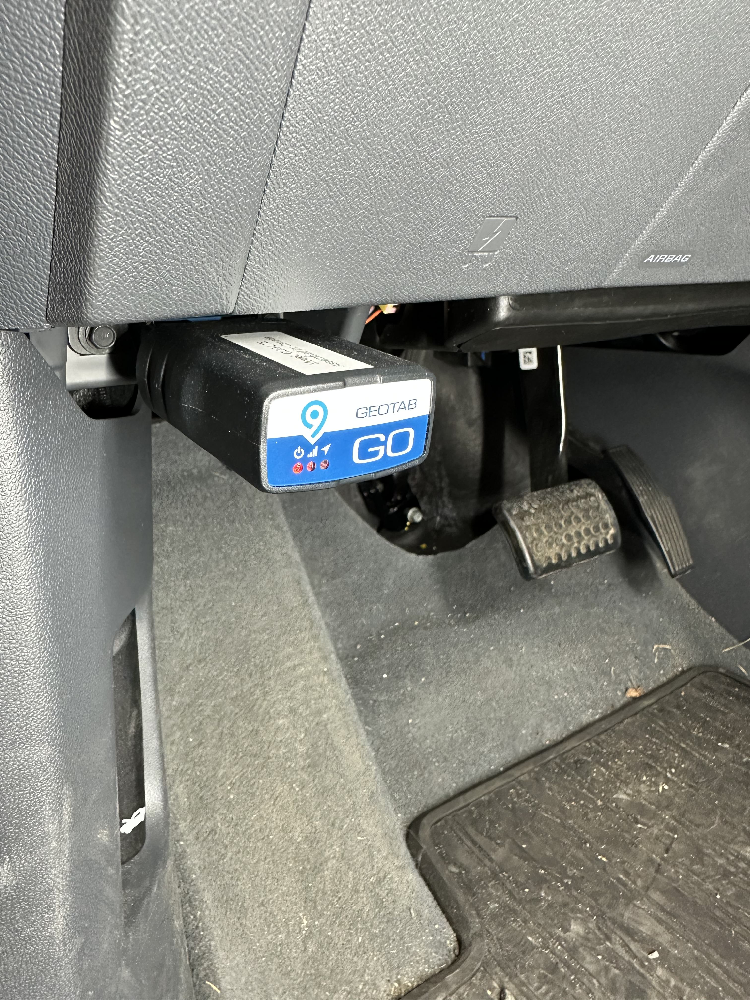
Notes:
So starting on February 24th I plugged the device into my car and was able to track data from every trip.
Every time I turn the car on, then off, it was logged as a trip and sent to an online account.
From there I was able to download my data into a .csv
I was able to collect the following data points for every trip:

Slide 7






Data Collection
Start/End Date Time
Distance Driven (mi)
Electricity Consumed (kWh)
Start/End State of Charge (%)
Outside Temperature (F)
GPS
Notes:
So starting on February 24th I plugged the device into my car and was able to track data from every trip.
Every time I turn the car on, then off, it was logged as a trip and sent to an online account.
From there I was able to download my data into a .csv
I was able to collect the following data points for every trip:
Start and End times with the data attached
Distance driven, in miles
Electricity Consumed, in kWh
What % my battery was at the beginning and end of the trip.
And the Outside Temperature.
I was unable to collect GPS data, because my device did not have this functionality.
Let’s now take a look at a quick summary of my entire trip dataset that I collected, and then we will jump straight into the mythbusting.

Slide 8


Notes:
The data set collection took place over 296 days.

Slide 9





296 Days
Notes:
Ranging from feb 24th 2022 to dec 17th 2022

Slide 10

1,092 Trips
296 Days
Notes:
1,092 Trips, mostly in the Westchester, NY area, but with road trips all over the northeast like, trips to western NY, Virginia, Penssylvania etc.

Slide 11
1,092 Trips
296 Days
23°F - 100°F
Notes:
With a range of temperatures from 23 degrees Fahrenheit to 100 degrees Fahrenheit

Slide 12
17,400 mi
1,092 Trips
296 Days
23°F - 100°F
Notes:
All trips totaling 17,400 miles

Slide 13
17,400 mi
4,251 kWh
1,092 Trips
296 Days
23°F - 100°F
Notes:
I used a total of 4,251 kWh, or the equivalent of using a household refrigerator for around 3 years
kWh is a unit of energy (not time)

Slide 14
17,400 mi
4,251 kWh
1,092 Trips
3.69 _{trips/day}
67.4 _{mi/day}
296 Days
23°F - 100°F
Notes:
I drove an average of 67 mi per day and had an average of 3.6 trips per day.
For reference the average american rives 37 mi per day
.
.
.
So now that I have an awesome dataset with over 1,000 observations, I am able to address these myths.
So let’s start with the first one, where we hone in on the distance data collected

Slide 15
Myth #1: EV’s can’t drive very far, and I’ll be stranded on the side of the road
Notes:
Myth #1: EV’s can’t drive very far, and I’ll be stranded on the side of the road

Slide 16

MYTH 1: EV’s Can’t drive very far and I’ll run out of battery.
AVG of 73% charge status
Meaning on average I would start a trip with 216 miles of range
And on avg I would End every trip with 199 miles of range.
And this is for every trip.
LONGEST single stint: 177 mi
Most mi per day: 351.69
Doesn’t reach the limit of the car
Ended trip with 5% only twice
My avg. trip was 15.9 miles long. And on average I drive 67.4 per day
And I’ve never run out of battery
Portable CHARGER picture have in the trunk.
I took 25 trips over 90 miles
Notes:
I never rang out of battery once.

Slide 17
What Else did I find when looking into distance/efficiency?
So an electric vehicle can handle a frequent driver, but how efficient is it?
On all 1092 trips I avg’d 4.5 mikWh or 152 MPGeq
Does anything in particular influence that efficiency?--> leads to temp influencing mikWh
Let’s ecplore some of the other data points to see!
-Distance
-Time of day
-Temperature

Slide 18
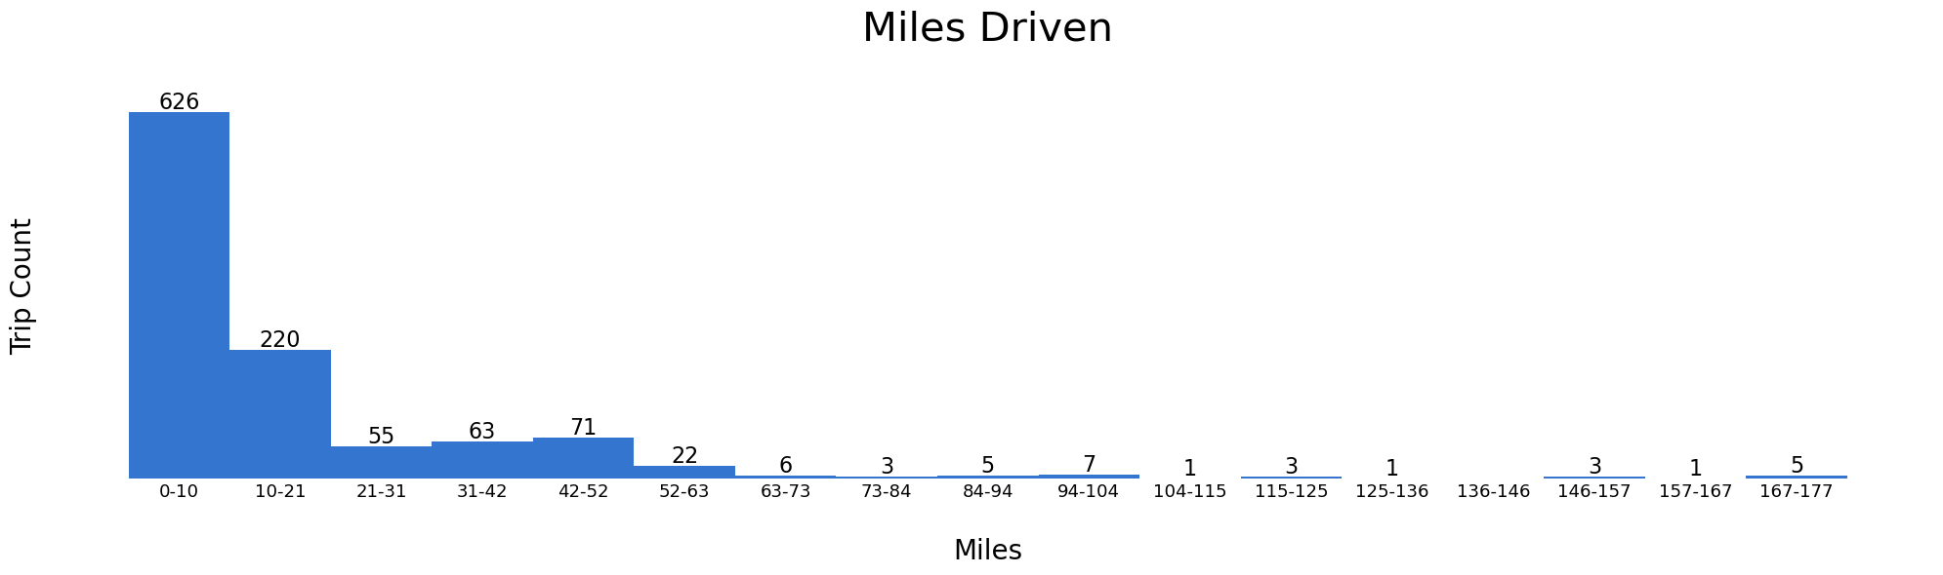

Slide 19
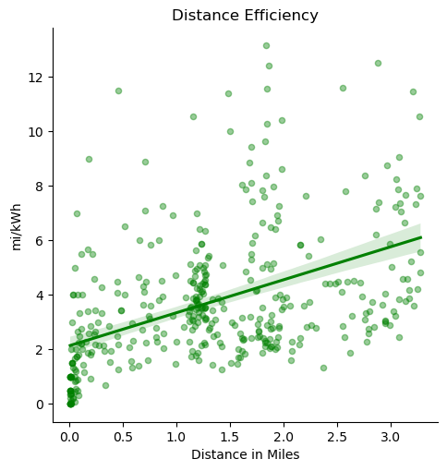

Slide 20
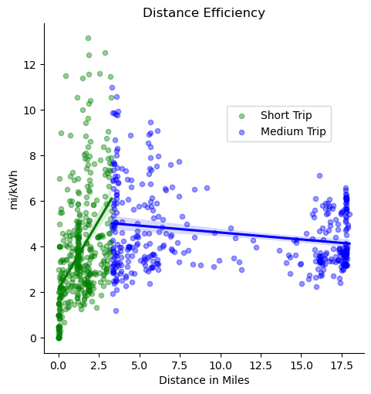

Slide 21
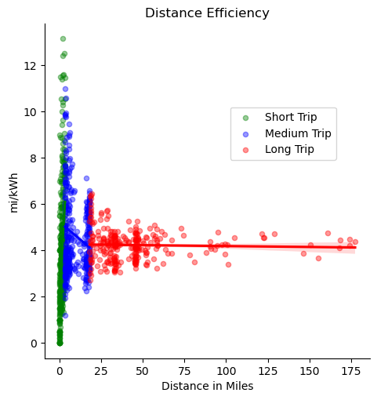

Slide 22
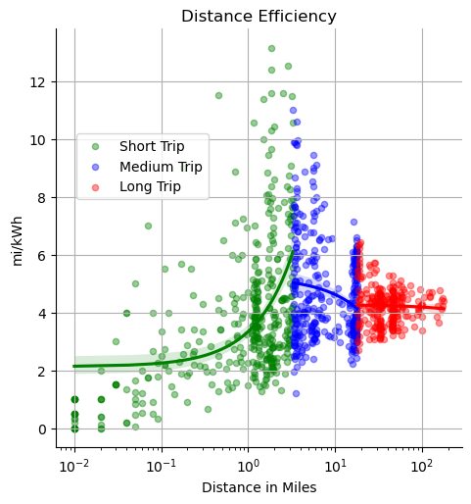
Mention the log and clear it up!!
In order to visualize this better
Log x axis, with out being squeezed and visualize better

Slide 23
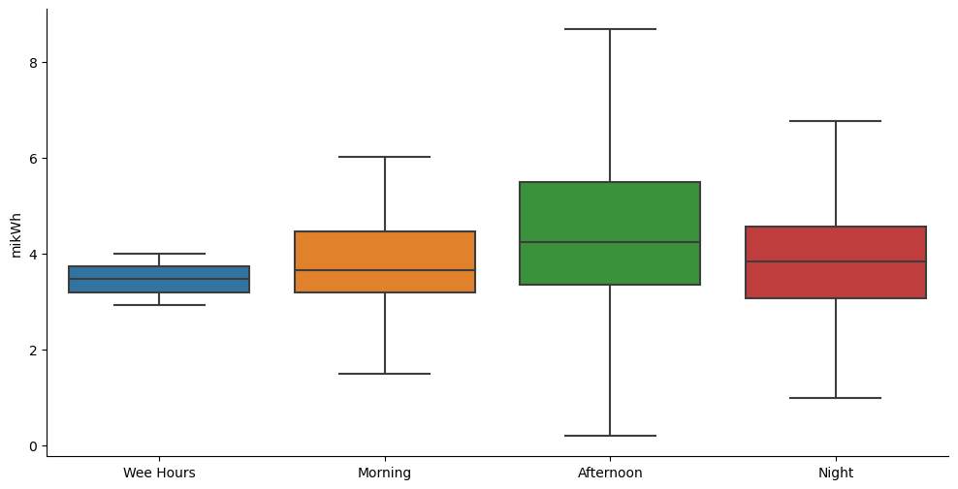
Notes:
What about time of day?
Traffic?

Slide 24
Leads us into
MYTH #2 EV Range is really bad, especially in the winter time
Let’s talk through the temperature part, because we already addressed the range portion of it

Slide 26
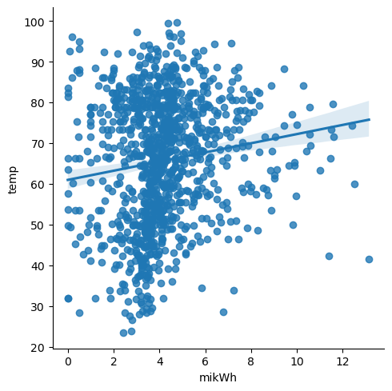
When I first did a scatterplot, it looks like SOME visual relationship between higher temperature, and higher efficiency, so let’s go one step further to break down cool and warm relationships to mikWh
For the entire range, it looks like some relationship, but to get a little more insight, let’s get more specific and segment the data.
Bin the data above 70 and below 40

Slide 27
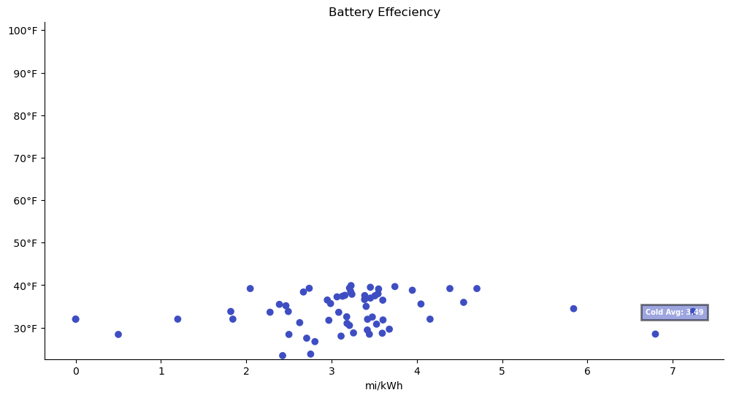

Slide 28
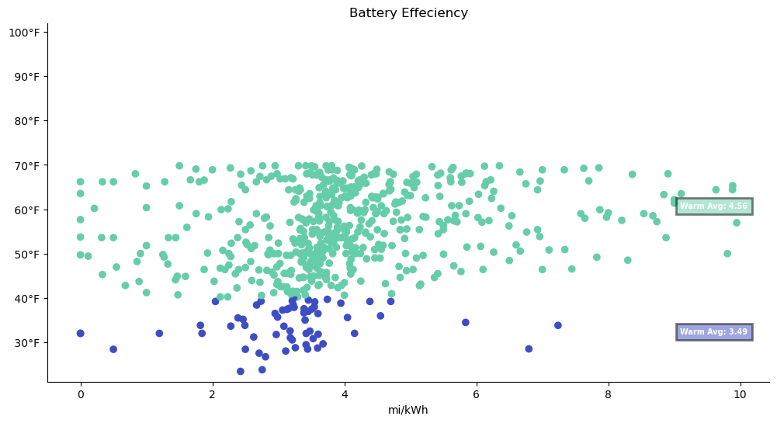

Slide 29
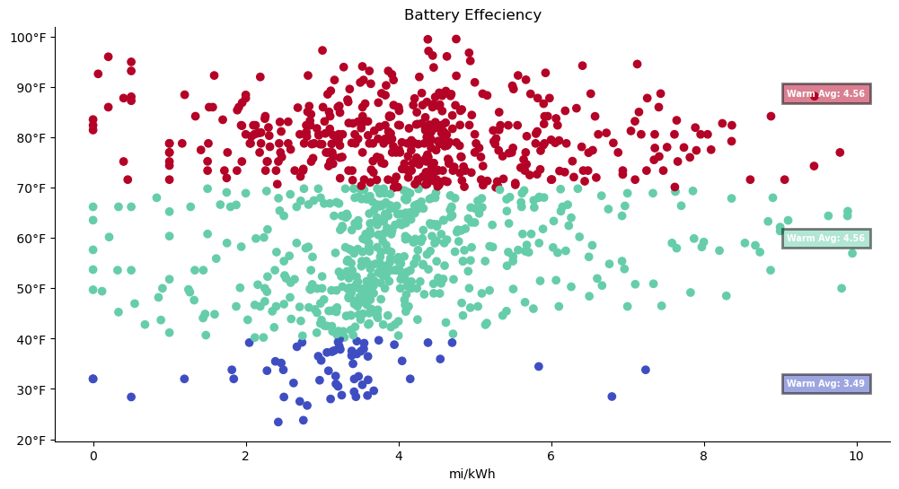

Slide 30
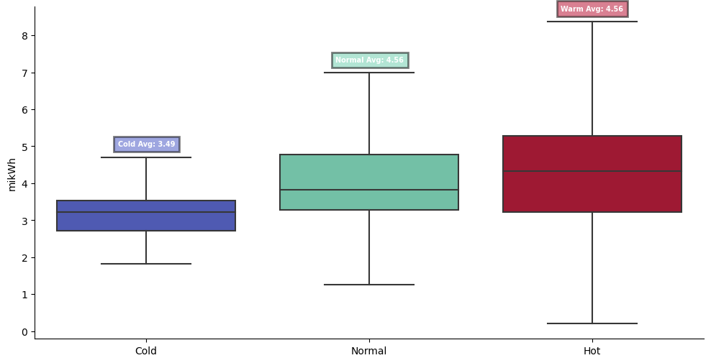

Slide 31
VISUAL
Scatter plot with three color coded categories, Cold, normal, warm
Try:
-Scatter
-Box

Slide 32
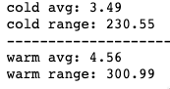
MYTH #2 Myth#2: An EV’s range is really bad, especially in the wintertime
.
Confirmed the fact that cold temperatures negatively affect effeciency
But how much of a degradation are we talking about?
If the battery is charged to 100%
70 miles lost in the winter time!!
I’ll say for daily driving it doesn’t make a difference!!!
Just on those long trips
And talking about Long Trips
Particularly I’ve found I prefer to only stop ONCE On a road trip, meaning whatever the range is, double it, and that’s the max trip you can make, i.e. in the cold, I could drive 460 miles(NYC→north Carolina) and in the warm I could drive 600 mi journey.(NYC→South Carolina). And that’s the longest journey I’d really want to make by car anyway.
<40 is cold
>70 is warm

Slide 33
Myth #3: It’ll cost a lot to charge my car at home , maybe even more than just filling up at a gas station
Let’s talk about cost savings!!

Slide 34
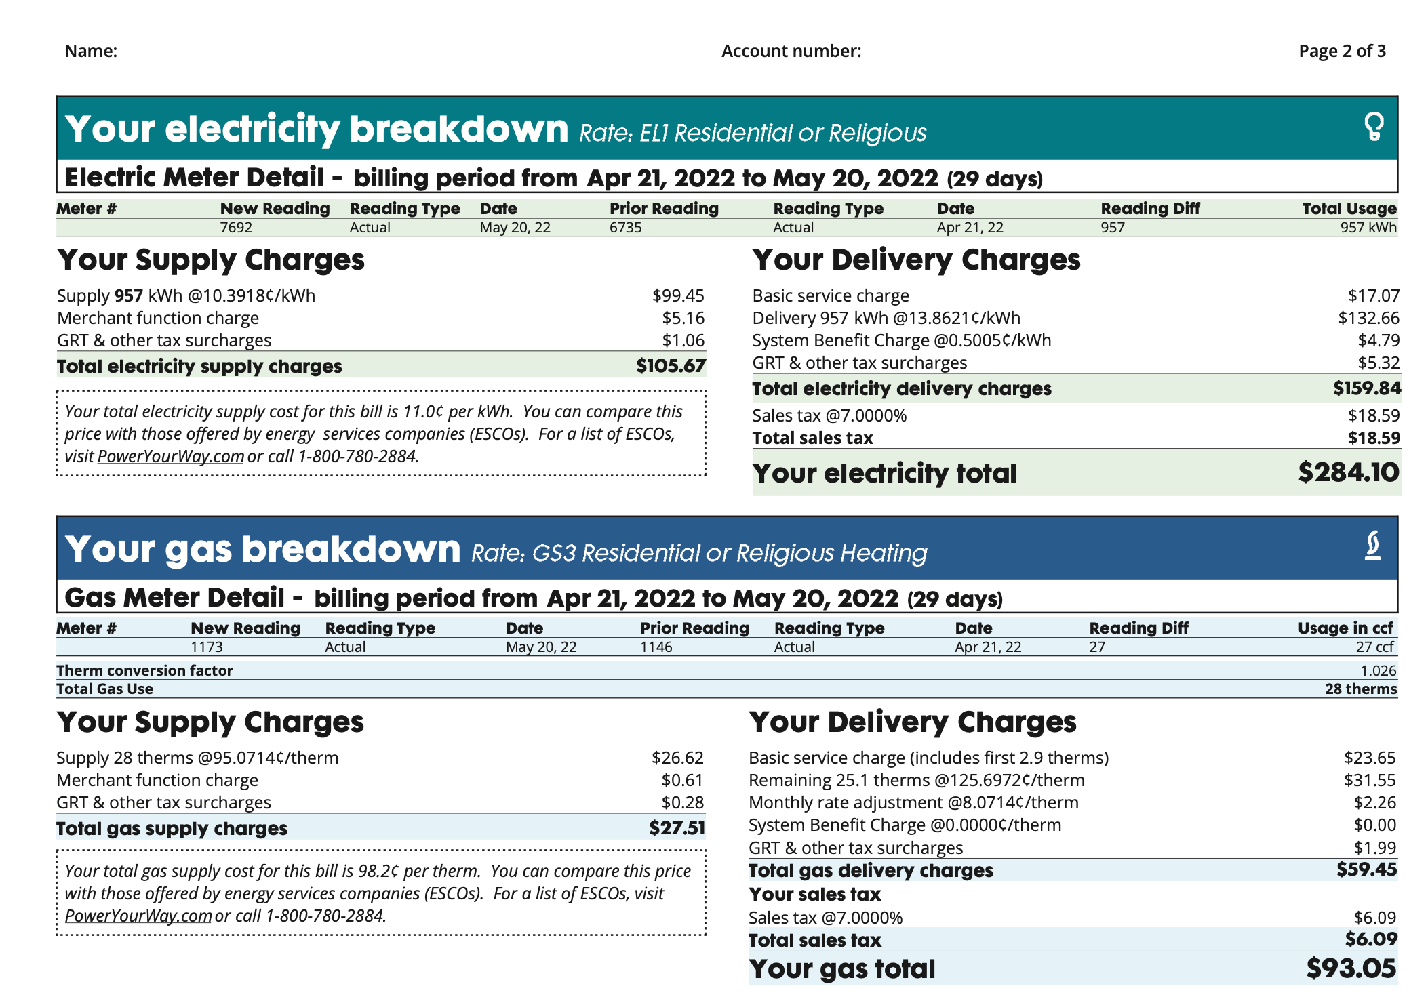
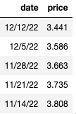
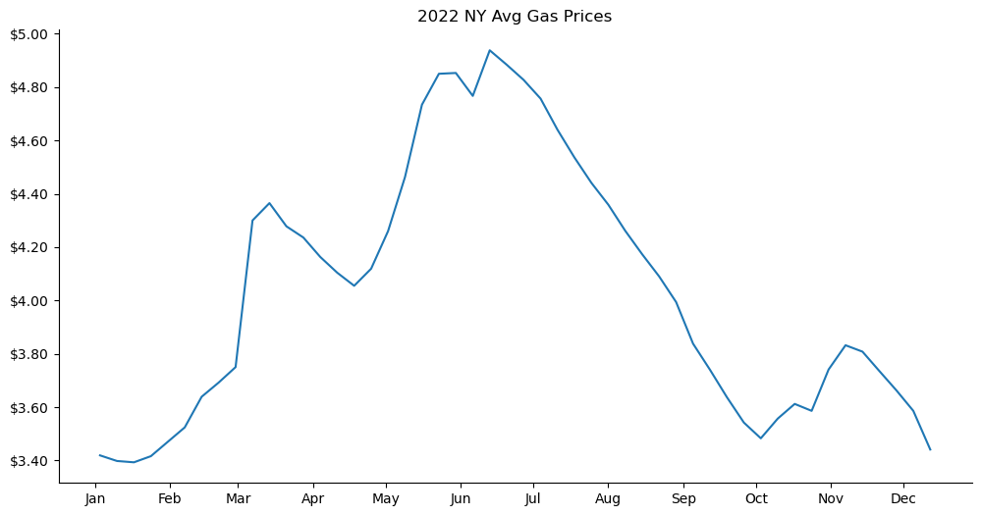
New Data Sources
Importing electric and gasoline costs for 2022
My Utility Bills in .pdf Form
US EIA Weekly Gas Price Averages
Compound dataset with this data
If you have more q’s about this, address it in the Q&A

Slide 35
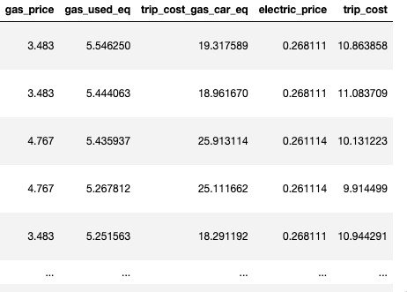
Get data at the trip level
Quick Assumptions to get some comparision. Our other car is 2005 Toyota Corolla which EPA says 29 MPG combined hwy/city

Slide 36
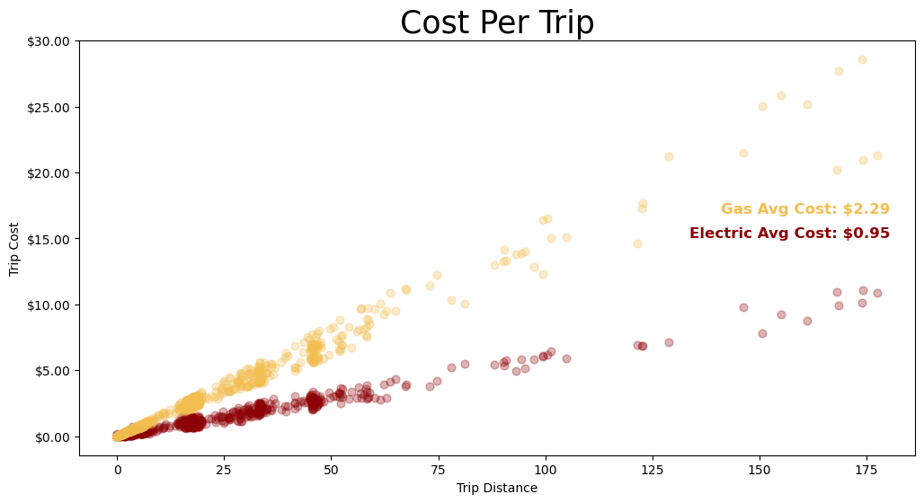
2 more graphs leading up to this one!

Slide 37
Myth#3
It’ll cost a lot to charge my car at home , maybe even more than just filling up at a gas station
$1,460.14 Saved this year, by using an electric vehicle instead of gas
Trips cost avg:
Electric: $0.95
Gas: $2.29

Slide 38
Conclusions
Myth 1:
Myth 2:
Myth 3:
Value Proposition: myth3 cost metric, and sales tactics, marketing these numbers

Slide 39
Private Data Set:
Becoming more and more accessible. Entering a new error of data collection. Our lives our FILLED with Data. Apple watch and fitness data, car data, travel data, etc. Self collected data through sensor. Growth of IOT. The past 10 years of tech. It used to happen at gov level, then corporate, than individual

Slide 40
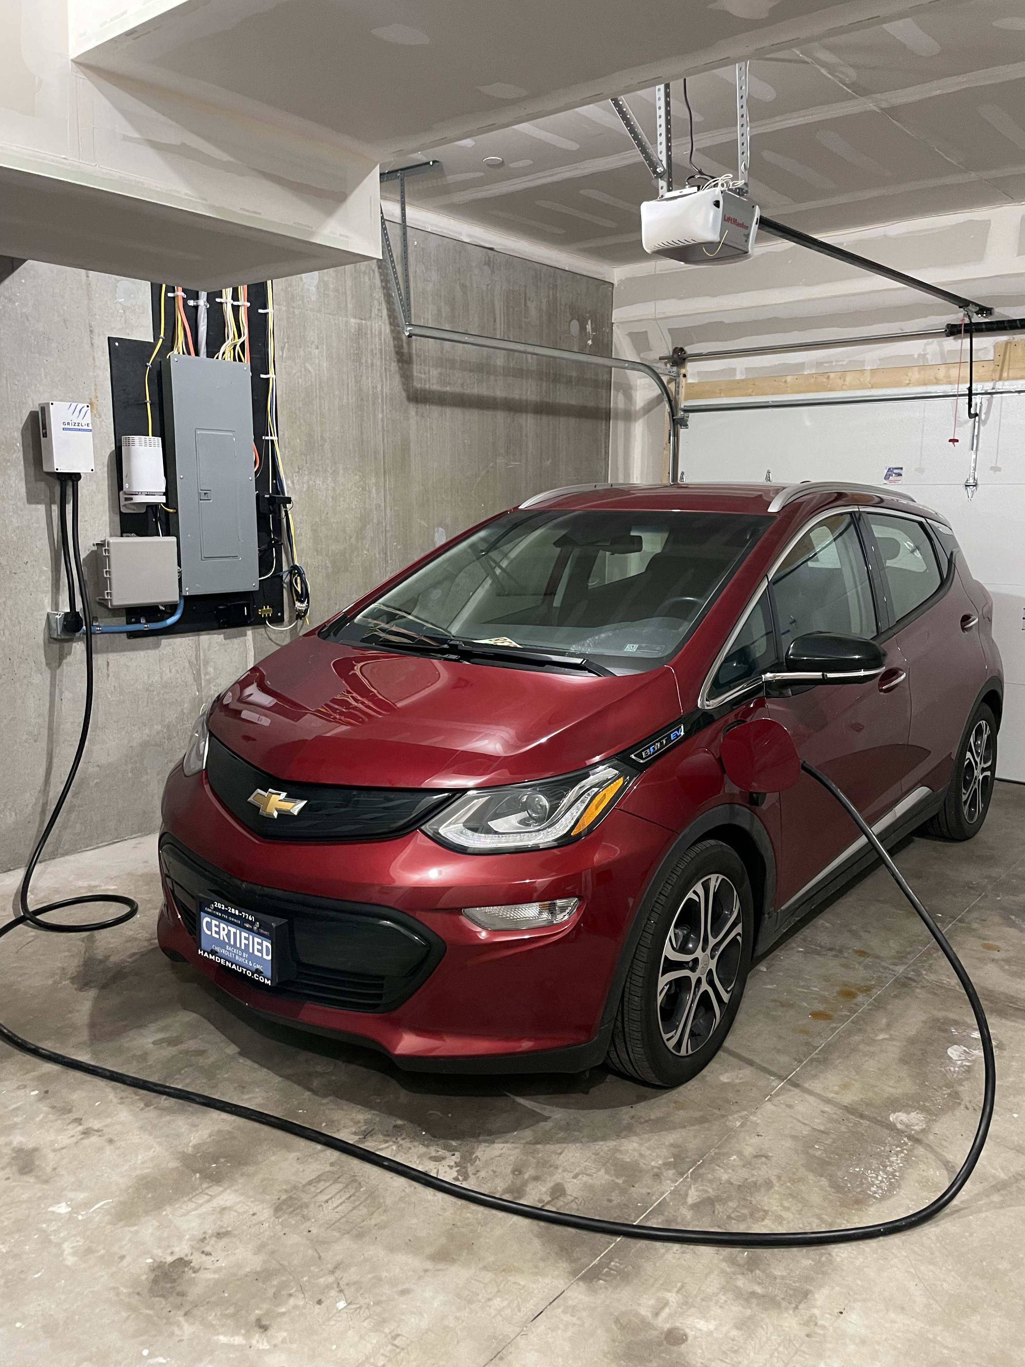
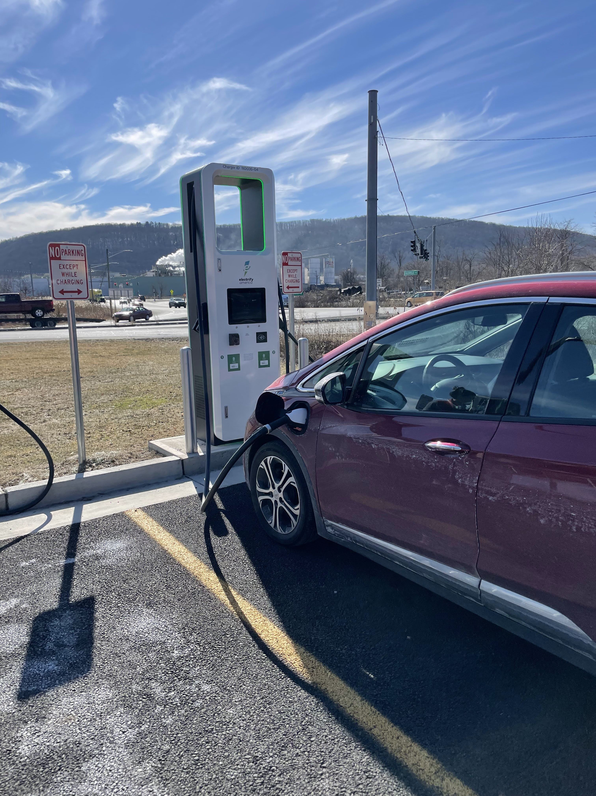
Notes and ideas about RANGE.
Three myths: yes
But…
Lifestyle is different than a gas car

Slide 42

"Data isn’t units of information. Data is a story about human behavior - about real people's wants, needs, goals and fears. Never let the numbers, platforms, charts and methodologies cloud your vision. Our real job with data is to better understand these very human stories, so we can better serve these people. Every goal your business has is directly tied to your success in understanding and serving people."
~ Daniel Burstein

Slide 43
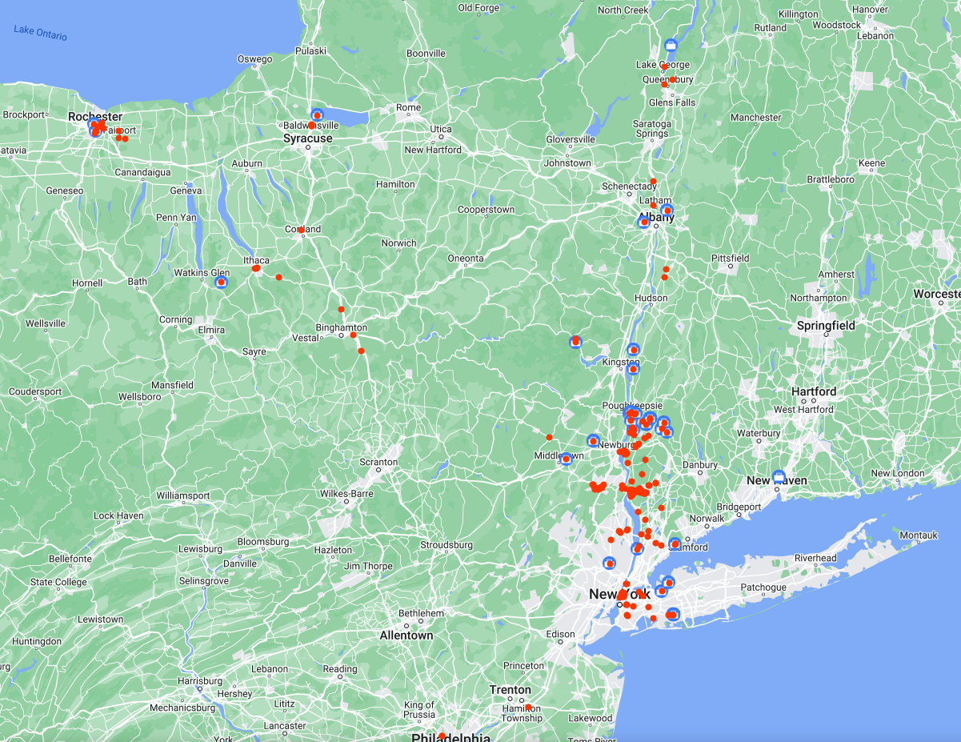
For the Future:
My device doesn’t collect GPS
I could collect GPS data
Or merge my google maps data
And collect data on elevation
changes
Etc.
This is my google maps timeline
Also pull in my charging data from outside my home
Also consider different lifestyles, Apartment living, city, etc.

